Slide 1
Updates & Reminders
Next week: Chapters 8 & 9: cellular functions of the tumor suppressors pRB and p53. read chapters and complete HW #3 by 2/3
Monday: Primary Literature Workshop #2
Before class: read “Requirement for p53 and p21 to sustain G2 arrest after DNA damage”, take notes, and be prepared for in-class workshop and discussions
Tuesday 2/4 by midnight: Project Submission Due

Slide 2
Chapter 7 objectives – continued-
Understand how LOH contributes to loss of tumor suppressor function
Be able to describe 4 ways to achieve LOH
Know what the consequences of LOH are on:
Each allele of the tumor suppressor
Each allele of a neighboring gene on the same chromosome
Each allele of a distant gene on the same chromosome
The appearance of the effected chromosome by karyotype analysis

Slide 3
Similarities and differences
LOH mechanism | # different tumor suppressor alleles? | # different non cancer gene alleles on chromosome | What stage of the cell cycle does this event happen? | changes obvious by Karyotype analysis?
Mitotic recombination | 1 | 1 (for regions near TS)/2 elsewhere | During or after S phase (not mitosis) | no
Hemizygosity | 2 | 1 (in area of deletion)/2 elsewhere | During or after S phase (not mitosis) | Deletions or translocations
Nondisjunction | 1 | 1 for the whole chromosome | mitosis | Only transient copy number changes
Gene Conversion | 1 | 2 | During replication | no

Slide 4
Summary of LOH
Each mechanism to achieve LOH is rare but more likely than random mutations in each allele of the same gene
Underlying defects may favor one LOH mechanism over another
Presence of DNA damage
defects in mitotic regulation
Some genes may be more/less sensitive to LOH by one mechanism than another
position on chromosome relative to centromeres and fragile sites

Slide 5
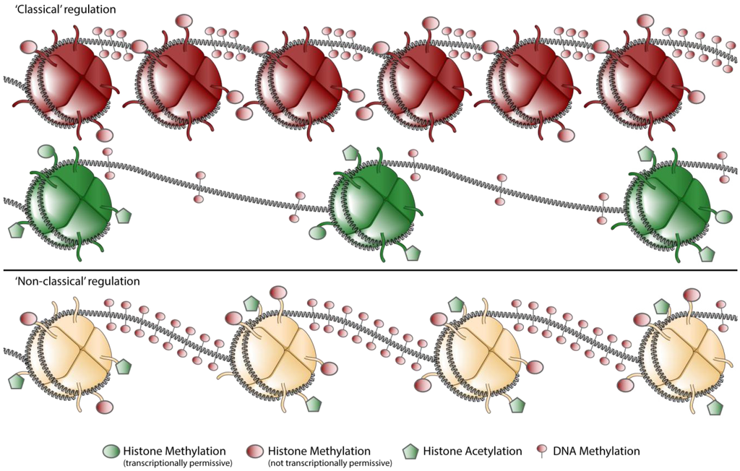
Loss of TS without gene mutations
Gene expression is regulated by chromatin compaction
Chromatin compaction is controlled by epigenetic regulation of histones and DNA
When promoters are heavily methylated the gene is transcriptionally silent
Genes not expressed
Genes expressed

Slide 6
Epigenetic mis-regulation in cancer
Mis-expression of the enzymes that regulate methylation is common in cancer
The impact of this misexpression can impact many genes (pleotropic)
EX:
DNMT3B: a DNA methyltransferase (places methyl marks on DNA) is highly expressed in colon cancer
Methylation may provide the 1st hit or the 2nd hit in loss of tumor suppressor function
Inactivation of both alleles by methylation is rare
2nd hit occurs more readily by LOH then by methylation of the second allele

Slide 7
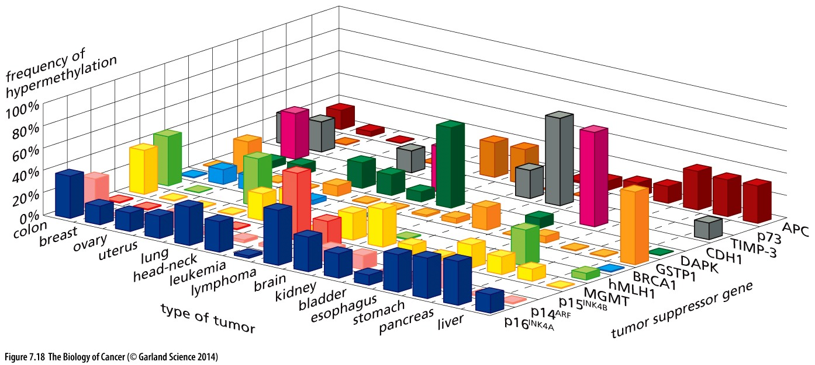
Epigentic misregulation in cancer
Common across cancer types
Impacts diverse tumor suppressor genes

Slide 8
A therapeutic window?
Genetic mutation is permanent
Epigenetic regulation is reversible
Enzymes place methyl marks
Other enzymes remove methyl marks
One methyl marks are removed, the gene can be transcribed
Cancer drugs that inhibit methyltransferase activity are actively being pursued in clinical and preclinical studies

Slide 9
Tumor suppressors: you don’t miss them ‘till their gone…
Must be lost or have an inactivating mutation in cancer
Are all genes that are lost of inactivated tumor suppressors?

Slide 10
Tumor suppressors: you don’t miss them ‘till their gone…
Must be lost or have an inactivating mutation in cancer
Not all genes that are deleted/mutated/or not expressed are tumor suppressors → may be:
located near a tumor suppressor
carrier mutation (consequence not a cause)
Developmental difference (lack of proper comparison)
Must undergo LOH (to lose BOTH copies)
Achieved through mutation or epigenetic silencing
Experimental restoration of pathological expression levels should halt tumor growth
Challenging, may halt normal cell growth as well
Engineered knockout should exhibit defects in proliferative regulation and be tumor-prone
Evidence of a cell biological/biochemical role in cell regulation?

Slide 11
Rules are meant to be broken…
Tumor suppressors normally function to limit tumor growth
tumor initiation and also malignant progression
Tumor suppressor genes encode tumor suppressor proteins
or microRNAs
The vast majority of tumor suppressors function recessively
Loss of both copies is required to provide a proliferative advantage
For some (like Nf1) haploinsufficiency provides an advantage

Slide 12
Chapter 8: pRB and Cell Cycle Control
Objectives
Be able to define the function of the cell cycle
Be able to describe the 4 cell cycle checkpoints: what each monitors, and the expected consequences if one or more is abrogated
Understand different ways protein function is regulated and be able to discuss examples of when each type of regulation may be used

Slide 13
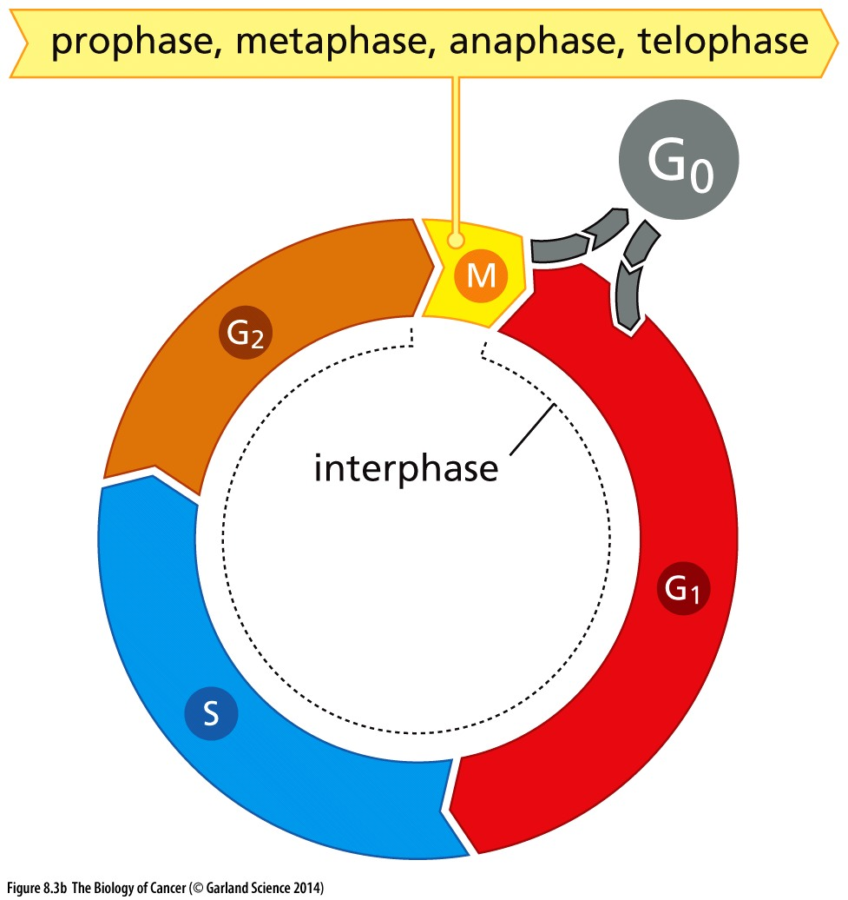

Cell cycle regulation
To be tumorigenic, a cell MUST proliferate inappropriately to generate additional cancer cells
The function of the cell cycle is the faithful duplication and equal separation of the genome during cell division
Cellular checkpoints are in place to ensure the cell is best equipped to do this

Slide 14
Cell cycle regulation
G1/S checkpoint monitors:
Mitogenic signalling (GFs)
Inhibitory signalling (TGF-beta)
for DNA damage
Intra-S phase & G2/M checkpoints monitor:
For DNA damage
Anaphase checkpoint monitors:
Chromosome attachment to the spindle microtubules

Slide 15
Cell cycle regulation
G1/S checkpoint monitors:
Mitogenic signalling (GFs)
Inhibitory signaling (TGF-beta)
for DNA damage
Intra-S phase & G2/M checkpoints monitor:
For DNA damage
Anaphase checkpoint monitors:
Chromosome attachment to the spindle microtubules
How do oncogenic TRKs promote proliferation?
Inhibition of which checkpoint might have a similar impact?

Slide 16
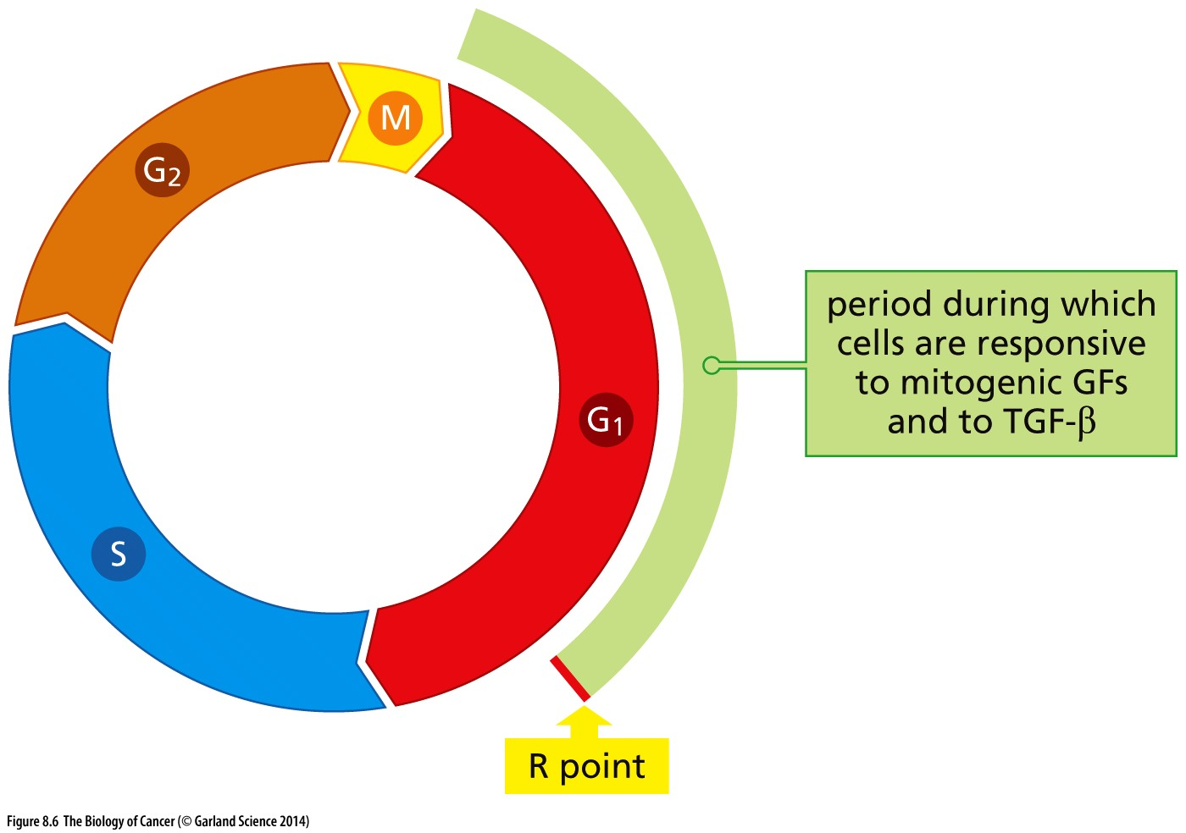
Cell cycle commitment
How do oncogenic TRKs promote proliferation?
oncogenic TRKs impact a cell’s decision to commit to a new cell cycle
Inhibition of which checkpoint might have a similar impact?
Abrogation of the G1/S checkpoint does the same
Restriction point: “Point of no return”
Mitogenic signal present? Nutrients available? Genome intact?
Yes → proceed to S phase
No → enter G₀/quiescence

Slide 17
Why a “point of no return”?
Why MUST a cell continue forward once it passes the R point?
At the G1/S transition replication is initiated: Replication must happen ONLY ONCE
Replication initiating complexes sit on chromatin and are primed to start replication upon S phase entry
How is protein function regulated?
Proteins required for replication initiation are turned over/degraded → not made again until the next G1

Slide 18
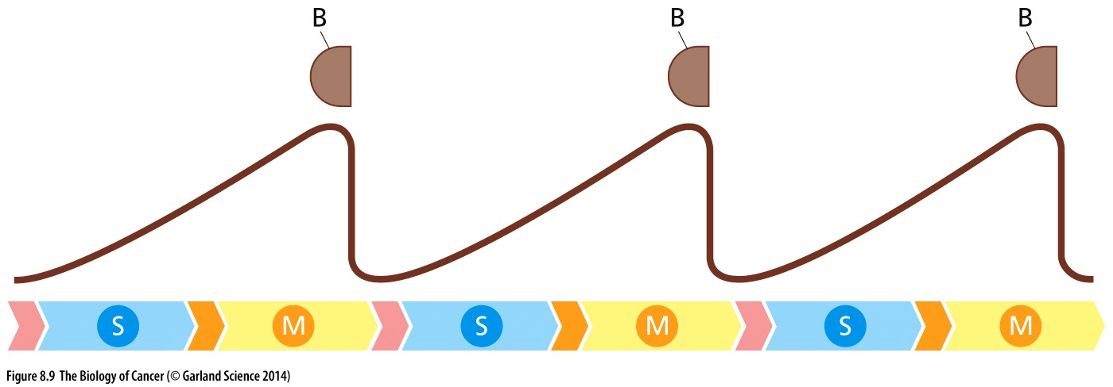
Protein degradation for irreversible regulation
Cyclin protein accumulates with cell cycle progression
Cyclin
Amount of cyclin protein
→ → → Cell cycle stage → → →

Slide 19
Protein degradation for irreversible regulation
Cyclin protein accumulates with cell cycle progression
Cyclin degradation at key steps in the cell cycle prevents cells from moving backwards
Cyclin
Amount of cyclin protein
→ → → Cell cycle stage → → →

Slide 20
Protein degradation for irreversible regulation
Cyclin protein accumulates with cell cycle progression
Cyclin degradation at key steps in the cell cycle prevents cells from moving backwards
Repeats this pattern with each cell cycle
Different Cyclin proteins have different expression profiles
Cyclin
Cyclin
Cyclin
Amount of cyclin protein
→ → → Cell cycle stage → → →

Slide 21
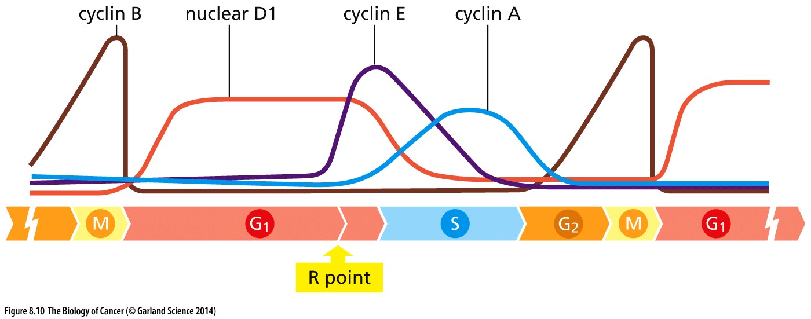
Protein degradation for irreversible regulation
Cyclin protein accumulates with cell cycle progression
Cyclin degradation at key steps in the cell cycle prevents cells from moving backwards
Different Cyclin proteins have different expression profiles
Amount of cyclin protein
→ → → Cell cycle stage → → →

Slide 22
Protein degradation for irreversible regulation
Cyclin expression/degradation patterns define cell cycle progression
Protein degradation is irreversible so the cell cycle ONLY moves forward
Amount of cyclin protein
What function do they serve? How do Cyclins regulate cellular pathways?

Slide 23
How is protein activity regulated?
Expression level: protein synthesis and degradation (cyclins)
Protein interactions (ligand binding, dimerization, protein complexes)
Covalent modifications (phosphorylation, methylation, etc)
Which types of regulation are reversible? Which are faster/slower?
Why might this level of control be needed?

Slide 24
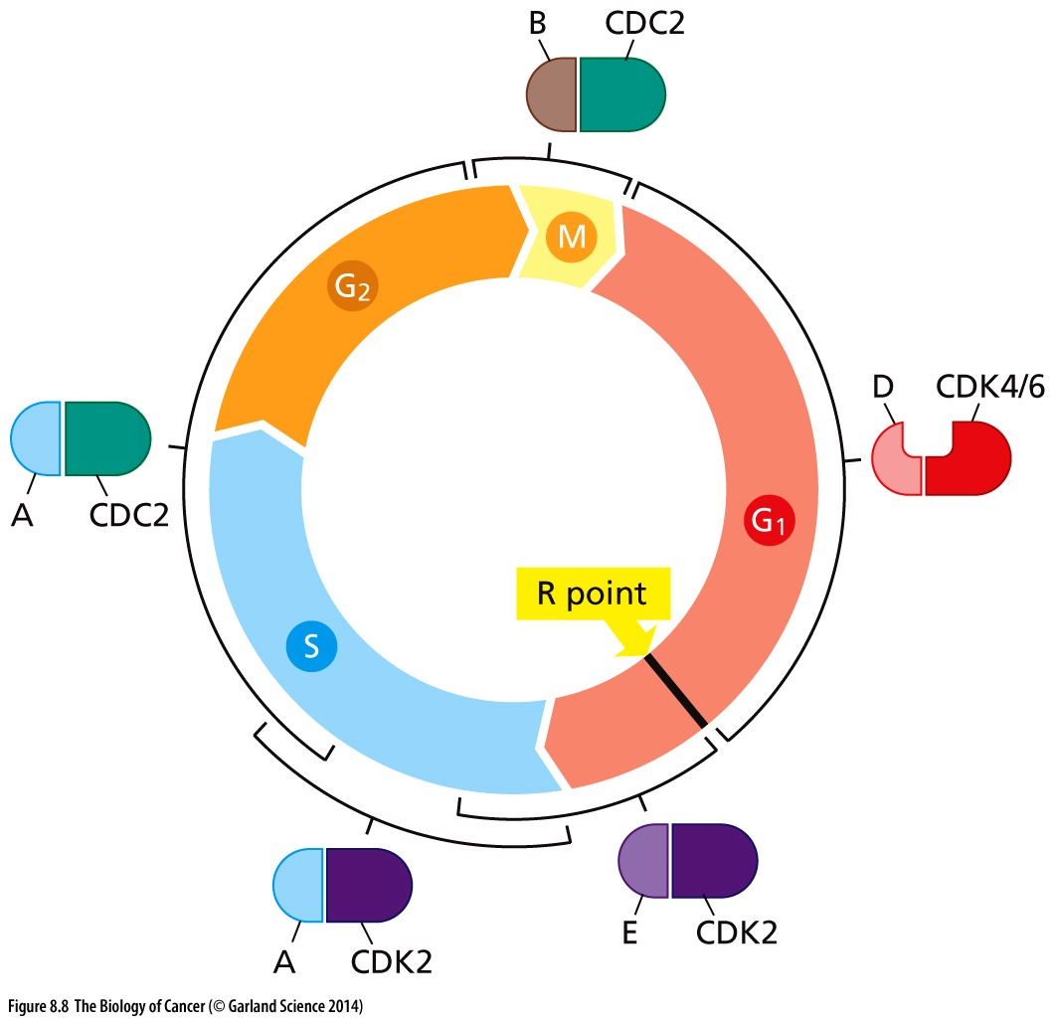
Different cyclins @ different cell cycle stages
Each cyclin protein complexes with one or two specific cyclin dependent kinases
Binding to cyclin activates the kinase
Kinase activity regulates important cellular functions
→ checkpoints!

Slide 25
pRB is regulated by Cyclin/CDK activity
pRB’s function as a checkpoint protein is regulated by phosphorylation
Cyclin D/CDK4/6 and Cyclin E/CDK2 phosphorylate pRB at the end of G1
pRB is inactivated by this phosphorylation → silencing the G1/S checkpoint
pRB is a dominant regulator of this checkpoint

